Slide 1
Topics
Introduction
Angular Core Features
Environment Setup
First Angular JS App
Data Binding

Slide 2
What is Angular JS
A client side JavaScript Framework.
Developed and maintained by Google.
Goals.
  Separate DOM manipulations from application logic
  Separation of concerns (MVC pattern)
  Make SPA development easier.
  Extensibility and customization.

Slide 3
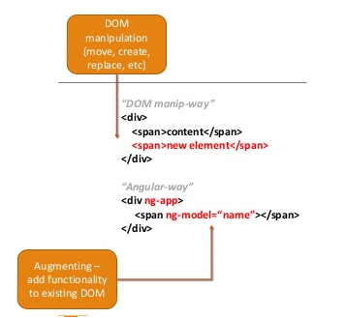
Angular JS DOM Manipulation

Slide 4
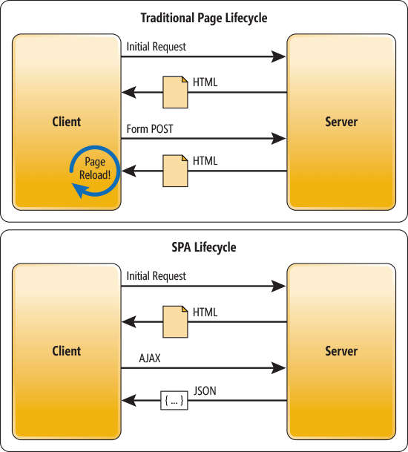
AngularJS SPA

Slide 5
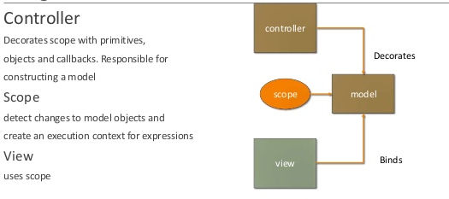
AngularJS MVC

Slide 6
Angular Core Features
Data Binding
Scope
Controller
Services
Filters
Directives
Routing
Dependency Injection in Angular.js

Slide 7
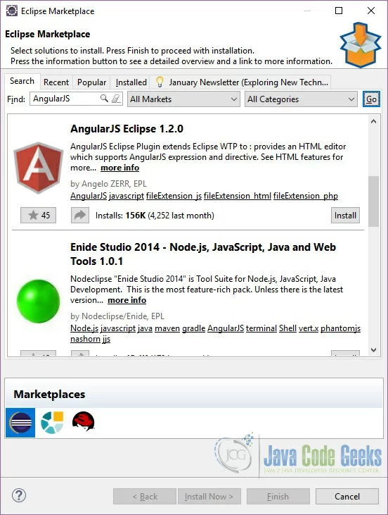
Environment Setup
Install Angular JS Plugin for eclipse
Open Eclipse and go to Help => Eclipse Marketplace… In the Find text box enter ‘AngularJS’ and press enter.
Look for the plugin ‘AngularJS Eclipse 1.2.0’. Click Install. Eclipse will ask you to confirm the selected features:

Slide 8
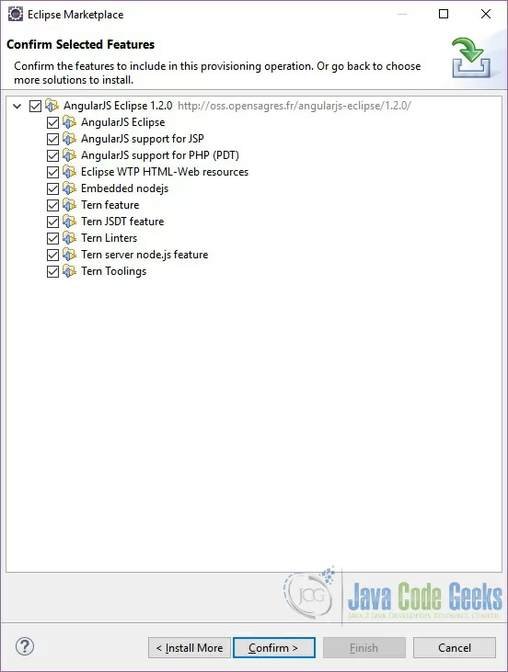
Environment Setup
Click Confirm. Eclipse will ask you to Review the Licenses. Click ‘I accept the terms of the license agreement‘ and press Finish.
Eclipse will start installing the Plugin. Eclipse will show you a Security Warning pop-up. Click OK.
Eclipse will ask you to restart for the changes to take effect. Click Yes.
To confirm that the plugin was installed correctly you can go to Help => Installation Details and look for the AngularJS Eclipse plugin in the Installed Software tab.

Slide 9
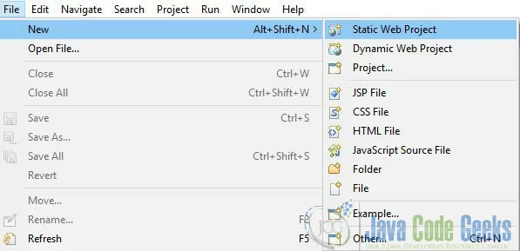
Creating Angular JS Project in Eclipse
Open Eclipse and go to File => New => Static Web Project.

Slide 10
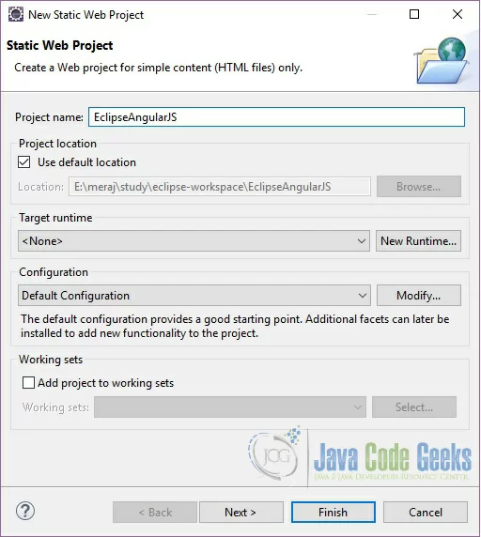
Creating Angular JS Project in Eclipse
In the New Static Web Project pop-up enter the project name and leave the other options as default.

Slide 11
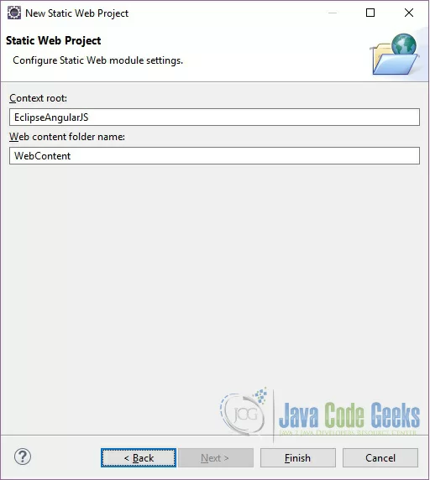
Creating Angular JS Project in Eclipse
Click Next. In this window you can modify the Context root and web content folder name.
For this example we will keep the default one. Eclipse use the project name as the context root and ‘WebContent’ as the web content folder name by default.

Slide 12
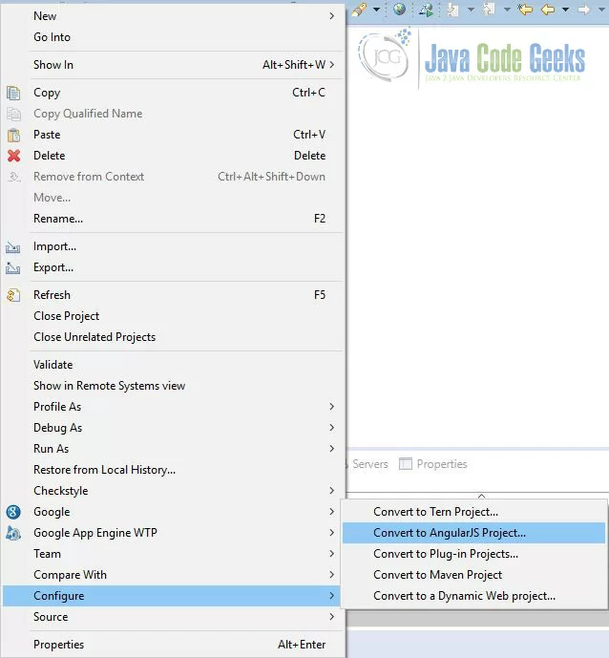
Creating Angular JS Project in Eclipse
Click Finish. Eclipse will create a project structure in your workspace.
Now we will convert this project to an AngularJS project. Right click on the project and go to Configure => Convert to AngularJS Project

Slide 13
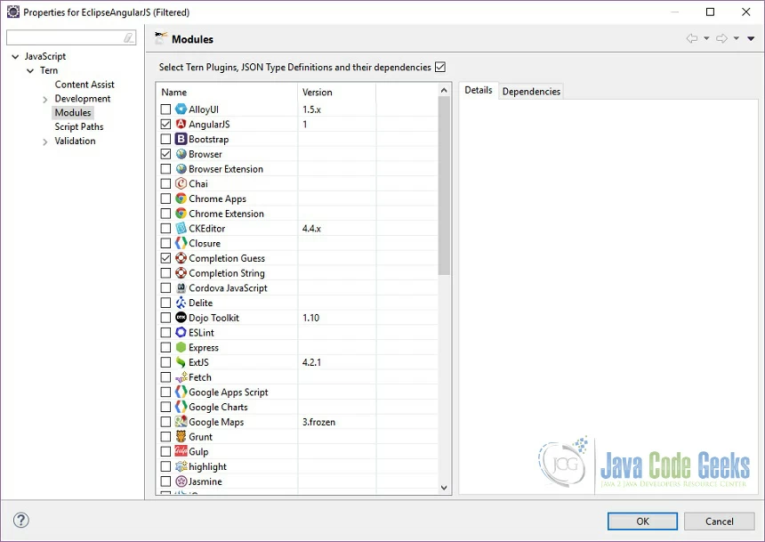
Creating Angular JS Project in Eclipse
In the next window Eclipse will ask you to choose any module property. Leave the default as it is and click OK.

Slide 14
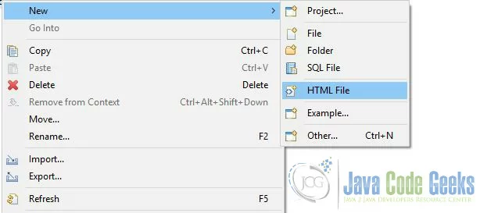
Creating Angular JS Project in Eclipse
Now we will create a new HTML file. Right click on the WebContent folder and go to New => HTML File.

Slide 15
Creating Angular JS Project in Eclipse
In the next window enter the file name (index.html). Copy the below code in the html file.
<!doctype html>
<html ng-app>
<head>
<script src="https://ajax.googleapis.com/ajax/libs/angularjs/1.6.1/angular.min.js"></script>
</head>
<body>
<div>
<label>Enter your name:</label>
<input type="text" ng-model="yourName" placeholder="Enter a name here">
<hr>
<h1>Hello {{yourName}}!</h1> <!-- Interpolation - bind model data to the view-->
</div>
</body>
</html>

Slide 16
AngularJS Page
ng-app directive indicates the start of AngularJS application.
ng-model directive then creates a model variable named "name" which can be used with the html page and within the div having
ng-app directive.
ng-bind or {{name}} then uses the name model to be displayed in the html span tag whenever user input something in the text box.
Closing</div> tag indicates the end of AngularJS application.

Slide 17
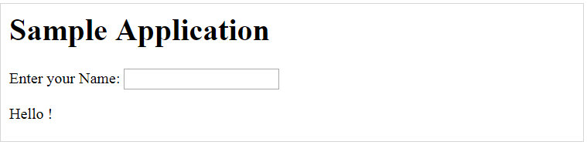
Output

Slide 18
AngularJS Process- High Level overview
AngularJS is included and executed.
AngularJS module get created.
Find templates.
  Template - HTML with some angular markup
  'ng-*' Attributes.
  Evaluate Expressions.
  Data-Binding.
Process Template.
  Compiles Template (for errors).
  Load template in browser memory.
  Transforms template with data.
Renders the DOM tree (view).

Slide 19
Data Binding
Data-binding in AngularJS apps is the automatic synchronization of data between the model and view components.
The view is a projection of the model at all times. When the model changes, the view reflects the change, and vice versa.

Slide 20
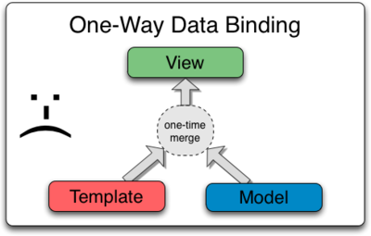
Data Binding in Classical Template Systems
Here the developer has to write code that constantly syncs the view with the model and the model with the view. You can think of the view as simply an instant projection of your model.

Slide 21
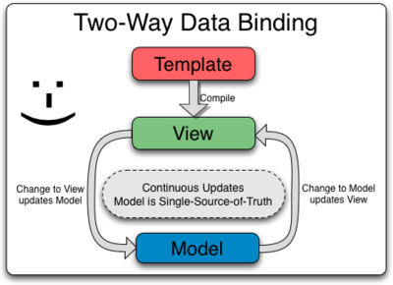
Data Binding in Angular JS Templates
Any changes to the view are immediately reflected in the model, and any changes in the model are propagated to the view.

